Slide 1
ADAPTER
PATTERN
A patterns-box talk
by
Miguel Salas

Slide 2
About me
Hi, I’m Miguel, Software Engineer at Belatrix. Currently working at La Seleccion Team developing Connovus innovation project

Slide 3
01
02
03
04
Goal
Real world case
Architecture
Problems it solves

Slide 4
05
06
07
08
When to use it?
When not to use it?
Common mistakes
Advantages and Drawbacks

Slide 5

Goal
“Make it fit”
Notes:
* Also known as wrapper.
* The adapter pattern converts the interface of one class into another interface the client expects (Understanding by interface to the contract between two classes).
* Allow classes to work together that couldn't otherwise due to incompatible interfaces.
* Future-proof client implementations by having them depend on Adapter interfaces, rather than concrete classes directly.

Slide 6

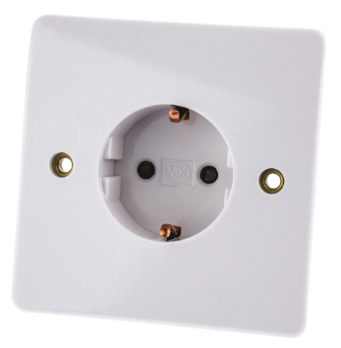
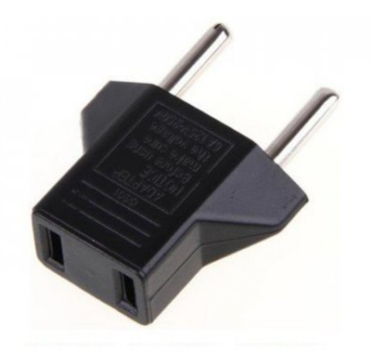
Real world case
Notes:
US plug (two vertical prones)
Adapter
European standard
If we live in a country that uses US plug standard (first image) and we travel to Europe with one of our devices, our laptop for example, we would soon realize that our laptop plug is incompatible with most of the outlets there since they comply with the European standard (third image). So, in order to use these outlets we need something that adapts our US plug to the European outlet, that's where the plug adapter comes in place (second image).

Slide 7
Architecture
Client
IAdapter
a_type a
request(a_type a)
Adapter
Adaptee
request(a_type a)
parse(b_type b)

Slide 8

Problem it solves
Not being able to pass information between two incompatible interfaces.

Slide 9

When to use it?
When there is a class whose interface do not match the one we need
When we want to future proof existing code that adapts an incompatible library
Notes:
When there is a class whose interfaces do not match the one we need. For example a library that would be helpful to your application does not implement the interface you require.
When we want to future proof existing code that adapts an incompatible library. This way we are not tied forever to the same libray but if needed, we can change it by implementing another adapter.
When we want to decouple our code from the usage of an specific external library. Since we are using an interface rather than a specific class, we can easily change from one adapter implementation to another.

Slide 10

When not to use it?
When we want to add behavior to the incompatible interface
Notes:
At that point, we are not implementing the adapter pattern but rather, the decorator pattern.

Slide 11

Common mistakes
Confusing the pattern with other ones:
Adding logic on top of the adaptee behaviour (Decorator)
Hide complex logic that the adaptee uses (Facade)
The goal of the adapter pattern is not to add, remove or alter the behaviour of the adaptee.

Slide 12
Advantages and Disadvantages

Slide 13

Advantages
Complies to the Open/Closed Principle
Increases reusability and flexibility
Testability
Clients become simplified
Notes:
* Complies to the Open/Closed Principle, since we are allowing our code to be open to extension but closed to modification. We decide how and which library to use when we implement our interface, and at the same time we enforce that the response of said library keeps being the same since that's what our client is expecting.
* Increases reusability and flexibility. We can reuse our interface anywhere we need to, again, implementing it with any library.
* Clients become simplified. All the adaption overhead is moved to the concrete implementation class.

Slide 14

Disadvantages
Multiple adapters
The rabbit trail effect
Prone to over-engineering

Slide 15
Demo

Slide 16

Thanks

